Slide 1
SYSEN 5400|Spring 2026|Cornell University
Next Generation
General Aviation
184,212
Aircraft System
Architectures
Explored
A Resilience-First Systems Engineering Approach
to Hybrid-Electric GA Aircraft Architecture
Full Factorial Enumeration
Team Members |Anurag Yadav (ay468) | Janhavi Gaikwad (jg2569)|Kris Singh(as4499)

Slide 2
Project
Scope &
Objectives
Key Objectives
01
Improve Reliability and Survivability
Reduce single-point failure exposure in propulsion and flight control
IN SCOPE
02
Reduce Operating Cost
Hybrid-electric propulsion architecture
Redundancy & fault-tolerance design
Advanced flight-envelope protection
Modular multi-mission platform
Part 23 certification compatibility
Target ≤$250/hr through hybrid efficiency and lower maintenance burden
03
Cut Carbon Emissions
Hybrid-electric architecture targeting ≥20% fuel savings vs. baseline
OUT OF SCOPE
Detailed aerodynamics & CFD
Structural sizing & FEA
Component-level design
04
Remain Certifiable
All architectures evaluated within FAA Part 23 requirements

Slide 3
Reference Architectures
Three anchors spanning the full GA design space
RA1 — Baseline
RA2 — Industry Standard
RA3 — Upper Bound
Cessna 172
Cirrus SR Series
NASA X-57
Conventional Single-Engine Piston
Modern Composite + CAPS Recovery
Distributed Electric Propulsion Demo
Mature, certifiable baseline
Single-point propulsion failure risk
No flight envelope protection
Benchmark for cost & simplicity
Ballistic parachute recovery system
Improved passive safety margin
Composite airframe construction
Current industry benchmark
Distributed motor architecture
Highest fault-tolerance potential
Emerging TRL — not yet certifiable
Sets redundancy design ceiling
← Mature & Certifiable
Experimental & Innovative →

Slide 4
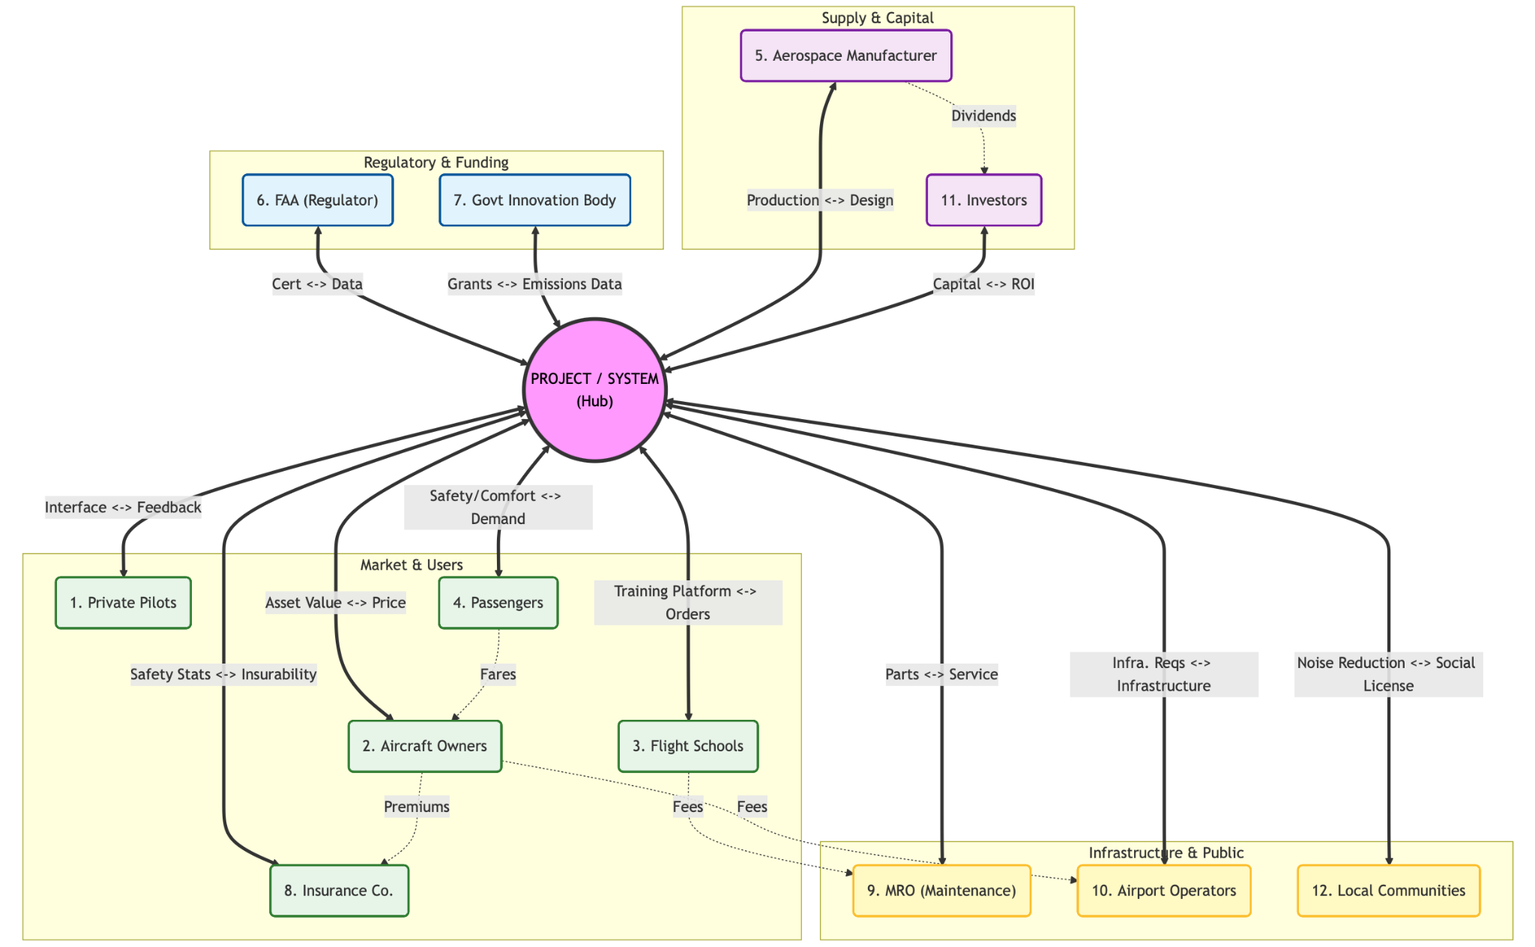
Stakeholder Value Network
SVN models how value, dependency, risk, and influence flow between the aircraft system and all connected stakeholders within the broader operational ecosystem.
1.Centralized hub-and-spoke ecosystem
2. Operator cluster drives network stability
3. Failures propagate beyond the aircraft itself
The aircraft behaves as a socio-technical ecosystem, not an isolated engineering product.

Slide 5
System Functional & Physical Architecture
Level 1 Functional and Physical Architecture represented, which are further decomposed in 22 and 18 Level 2
PRIMARY FUNCTIONS
PHYSICAL SUBSYSTEMS
F1 Generate & Manage Propulsion Hybrid powertrain, energy flow, redundancy
Propulsion System Thermal engine, electric motors, gearbox, propeller
F2 Control Flight Path Pilot inputs, fly-by-wire, envelope protection
Electrical & Energy System Battery packs, power electronics, PDU
F3 Monitor & Ensure Safety Fault detection, CAPS, emergency recovery
Flight & Control System FCC, actuators, avionics, control surfaces
F4 Manage Avionics & Comms Navigation, displays, autopilot, ATC link
Safety & Support System Health monitoring, env. ctrl, backup power
F5 Support Cabin & Payload Cabin environment, modular payload bays
F6 Maintenance & Health Management
Airframe Fuselage, wings, tail, landing gear, structure
Decisions D1–D8 are subsystem-level architectural choices, each directly maps to one or more physical blocks above

Slide 6
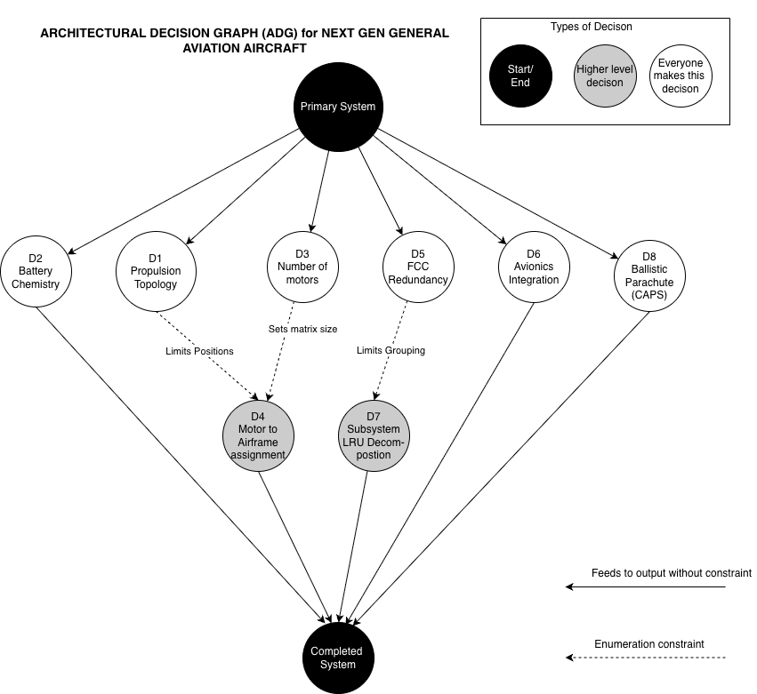
Architectural Decision Graph (ADG)
Four enumeration-level constraints reduce feasible architectures, decisions are NOT independent
Enumeration-Level Constraints:
D1 → D4
Topology limits valid motor mounting positions
D3 → D4
Motor count sets the size of the position matrix
D5 → D7
Triple FCC forces ≥3 separate LRU packages
D6 → D7
Avionics style constrains LRU co-packaging rules

Slide 7
Architecture Decisions & Space Size
How 184,212 feasible architectures are derived all exhaustively evaluated, no sampling
Decision | Type | Size | Notes
D1 Propulsion Topology | SF | 3 | Series / Parallel / Turboelectric
D2 Battery Chemistry | SF | 3 | NMC / LFP / Solid-State
D3 Number of Motors | SF | 3 | 1 / 2 / 4 motors
D4 Motor Position | DS | 51 | Constrained by D1×D3 — n=4 or 5 positions
D5 FCC Redundancy | SF | 3 | Simplex / Dual / Triple
D6 Avionics Integration | SF | 2 | Federated / IMA
D7 LRU Decomposition | PA | 301 | Constrained by D5×D6 — S(6,2) + S(6,3)
D8 CAPS Parachute | SF | 2 | Installed / Not Installed
Total Feasible
Architectures
184,212
= 51 × 3 × 301 × 2 × 2
Full enumeration.
No sampling used.
All configs evaluated.
SF = Standard Form (pick-one) · DS = Downselecting · PA = Partitioning

Slide 8
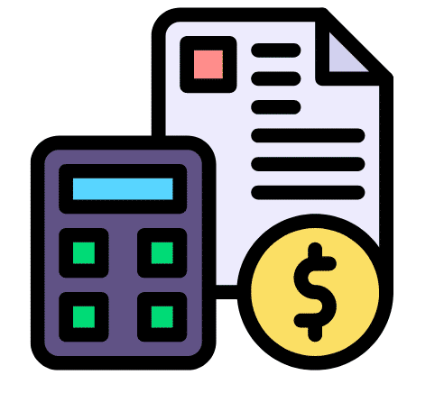



Performance metrics
Operating cost
Certification schedule
Propulsion reliability
System Durability
Unit : $/hr
Cost → C = sum C(Di)
Subsystem costs sum linearly (first‑order fidelity)
Unit : Years
S = max(S_seq, S_par)
Sequential D1->D5->D6 lane vs concurrent tracks
Unit : Years
L = min(L_series, L_parallel),
Capturing weak‑link physics vs redundancy uplift
Unit : %
R = R_series * R_parallel
Blending propulsion chain sensitivity with tolerant FCC/avionics/LRU redundancy
Notes:
Operating Cost: Market is sensitive to how much money required to perate an aircraft
Certification schedule : Time to development is mostly driven by the certification schedule for new tech like electric engines
Propulsion reliability : Essential due to aircraft reliability is heavily influenced by propulsive components
System durability L assess the lifetime of the aircraft

Slide 9

Multi-Objective Genetic Algorithm (NSGA-II) for Architecture Selection
OPTIMIZATION FLOW
OPTIMIZATION OBJECTIVES
Population size(Start)
200 Architectures
↓
Minimize Operating Cost
↓
Minimize Certification Schedule
▼
↑
Maximize Reliability
Decision Encoding
Integer → 26-bit Chromosome
↑
Maximize Durability
GA CONFIGURATION
▼
NSGA-II Optimization
Selection · Crossover · Mutation · Repair
Population Size
200
Generations
200
Uniform Crossover
0.8
▼
Mutation Probability
0.1
Fitness Evaluation
Cost ↓ | Cert Time ↓ | Reliability ↑ | Durability ↑
Elitism
10
CONSTRAINT HANDLING
▼
Pareto-Optimal Architectures
Final Output
• Repair-based feasibility correction
• Penalization of infeasible architectures
KEY OBSERVATION
Rapid convergence within ~20 generations
Key decisions: D1 · D3 · D5 (FCC) · D7 (LRU)
KEY INSIGHT The GA rapidly identified a constrained Pareto region where balanced architectures outperformed extreme high-complexity designs.
Notes:
The slide shows NSGA based genetic algorithm used for selecting best architecture from 184000 feasible architecture
Architecture 8 decision is converted into 26 bit chromosome which allowed GA to explore tradespace through repair crossover mutation
Optimization reduce cost time while increasing reliability durability creating balanced tradeoff Constraint handling done via repairing chromosome..which is also a reason that algorithm converges withing 20 iterations

Slide 10
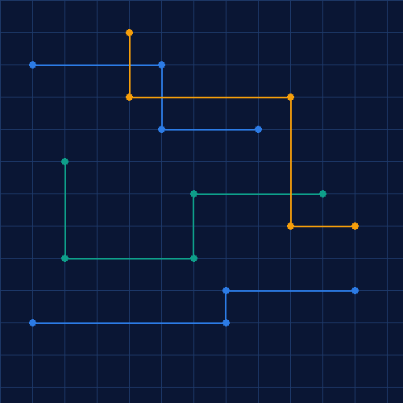
Selected Architectures
ARCHITECTURE COMPARISON
Metric | Architecture A | Architecture B
Decision Vector | 0,1,1,0,0,1,1,0,0,0,0,0,0,1,0,0,0,1 | 0,1,1,1,1,0,0,0,0,0,0,0,0,1,1,1,0,1
Operating Cost | 1,450 $/hr | 1,450 $/hr
Certification | 5.5 yrs | 5.5 yrs
Reliability | 99.1% | 99.1%
Durability | 8 yrs | 8 yrs
Key Feature | Balanced redundancy | Concentrated fault tol.
ENGINEERING INTERPRETATION
Pareto front is discrete and clustered (combinatorial space)
Multiple decision vectors map to similar objective values
GA converged rapidly to stable high-performing architectures
Balanced architectures outperform extreme distributed configs
⚠ Limitation: Simplified additive cost and reliability assumptions reduce interaction sensitivity.
KEY FINDING The Pareto front is clustered, indicating high-performing architectures share common structural decisions — enabling robust engineering trade-off selection.
Notes:
We can observe here that for all top architecture metrics are almost same even if decision vector is different. I.e same metrics are achieved via different combinations
It also indicate presence of simplified cost modeling, and deterministic reliability and schedule modeling

Slide 11
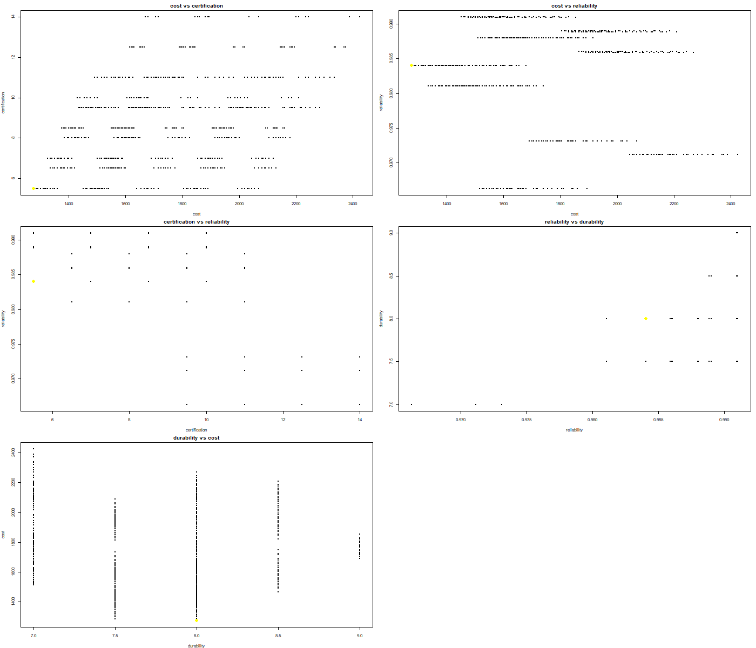
Tradespace & Selected Architecture- I
Cost vs Reliability
Durability vs Cost
Reliability sits on horizontal ridges while cost varies widely; yellow highlights where your selected architectures sit on the cost–reliability trade
Vertical bands mean many cost levels exist at each durability level; yellow pinpoints minimum (or chosen) cost at the target durability band

Slide 12
Tradespace & Selected Architecture- II
Cost vs Certification schedule
Certification schedule vs Reliability
Discrete horizontal bands show how cost stratifies at fixed certification times; the yellow point marks one MOGA/Pareto solution set in that 2‑D slice
Grid-like pattern from discrete cert levels and reliability bins; yellow shows solutions’ regulatory-time vs safety posture.

Slide 13

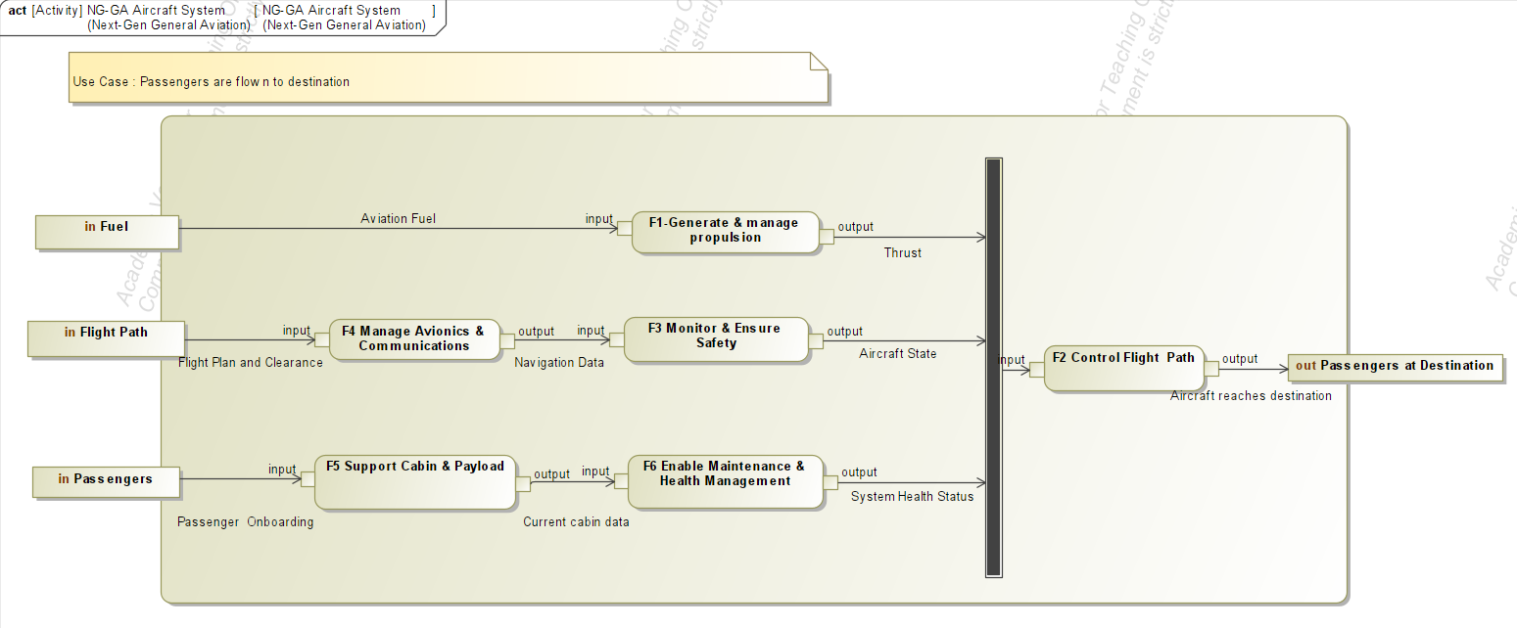

Optimal Architecture: Balanced Efficiency
Operational Lifecycle & Use Cases
Selection of Pareto-Optimal Architecture A via MOGA Optimization
State Transitions and Functional Flow for the RUGA Aircraft
Propulsion (D1)
Parallel Hybrid
Energy Storage (D2)
Li-Ion (High Density)
Motor Setup (D3/D4)
2+ Motors, Wing-Mounted
Control (D5/D6)
Dual-Lane FCC & IMA
Safety (D8)
CAPS Installed
Primary Use Case: Conversion of fuel/energy (F1) into thrust to control flight path (F2), supported by real-time safety monitoring (F3) and automated avionics (F4).
Lifecycle States: The system transitions from Idle through Pre-Flight to Cruising, with a dedicated Emergency state triggered by system faults.
Resilience Logic: Any flight-phase fault routes immediately to the Emergency state, prioritizing ground resolution or emergency landing over mission completion.
$1450
Op. Cost / hr
5.5 yr
Cert. Schedule
99.1%
Reliability
8 yr
Durability

Slide 14
System Hierarchy & Physical Blocks
Mapping 22 Level-2 Sub-functions to 5 Primary Physical Subsystems
Subsystems
Physical Core
Intelligence Layer
Airframe (B1)
Propulsion (B2)
Electrical/Energy (B3)
Flight Control (B4)
Safety/Support (B5)
The parallel hybrid powertrain
integrates a thermal engine
(B2.1) with electric motors (B2.2)
via a mechanical gearbox (B2.3).
Dual Flight Control Computers
(B4.1) manage the "Control
Path" while the Health
Monitoring System (B5.1)
governs the "Resilience Logic."

Slide 15
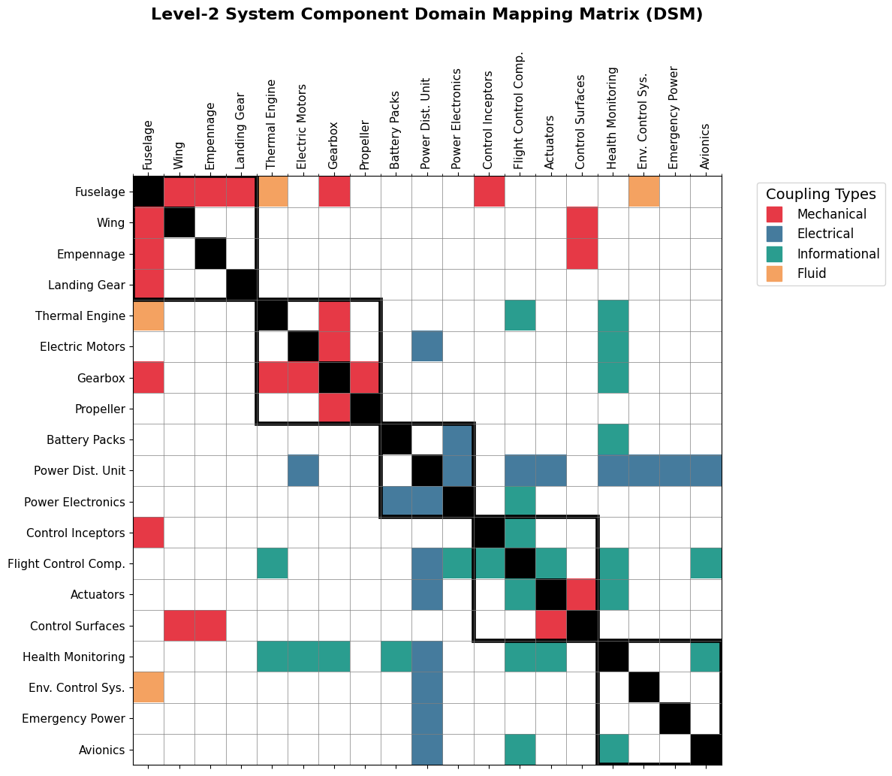
System Connectivity & Allocation
High-Density Coupling and Interface Management
Interface Hubs: The Airframe acts as the physical hub (structural support), while the Power Distribution Unit (PDU) acts as the electrical bus.
Allocated Logic: Safety functions (F3, F6) are strictly allocated to the Safety & Support subsystem to ensure prognostic independence.
DSM Insights: Level-2 analysis reveals dense mechanical coupling in the propulsion chain and high informational connectivity for the FCC and Health Monitoring units.

Slide 16
Conclusion
Summary of Findings, Targets, and Future Technical Growth
Key Findings
Metrics vs. Targets
Future Work
Architecture Hubs: Propulsion Topology (D1) and Motor Count (D3) drive the greatest system impact.
The "Safety Rule": Series hybrids with wing-centered redundancy and CAPS augmentation consistently dominate the Pareto front.
Redundancy Requirement: Propulsion redundancy is structurally necessary for market competitiveness.
Reliability: 99.10% (Target: ≥99%) – MET
Durability: 8 Years (Target: G4) – MET
Schedule: 5.5 Years – BALANCED
Transition from conceptual
surrogate models to high-fidelity
physics-based simulations
(CFD/FEA) and stochastic
certification risk modeling.

